Slide 1
Let’s build a computer
Made by Aron Geosits
For circa 1000$
Made by Aron Geosits

Slide 2
TABLE OF CONTENTS
01
04
RAM
07
Storage
The CPU
02
The CPU Cooler
05
08
The GPU
The Case
03
The Motherboard
06
The Power Supply
09
Peripherals

Slide 3
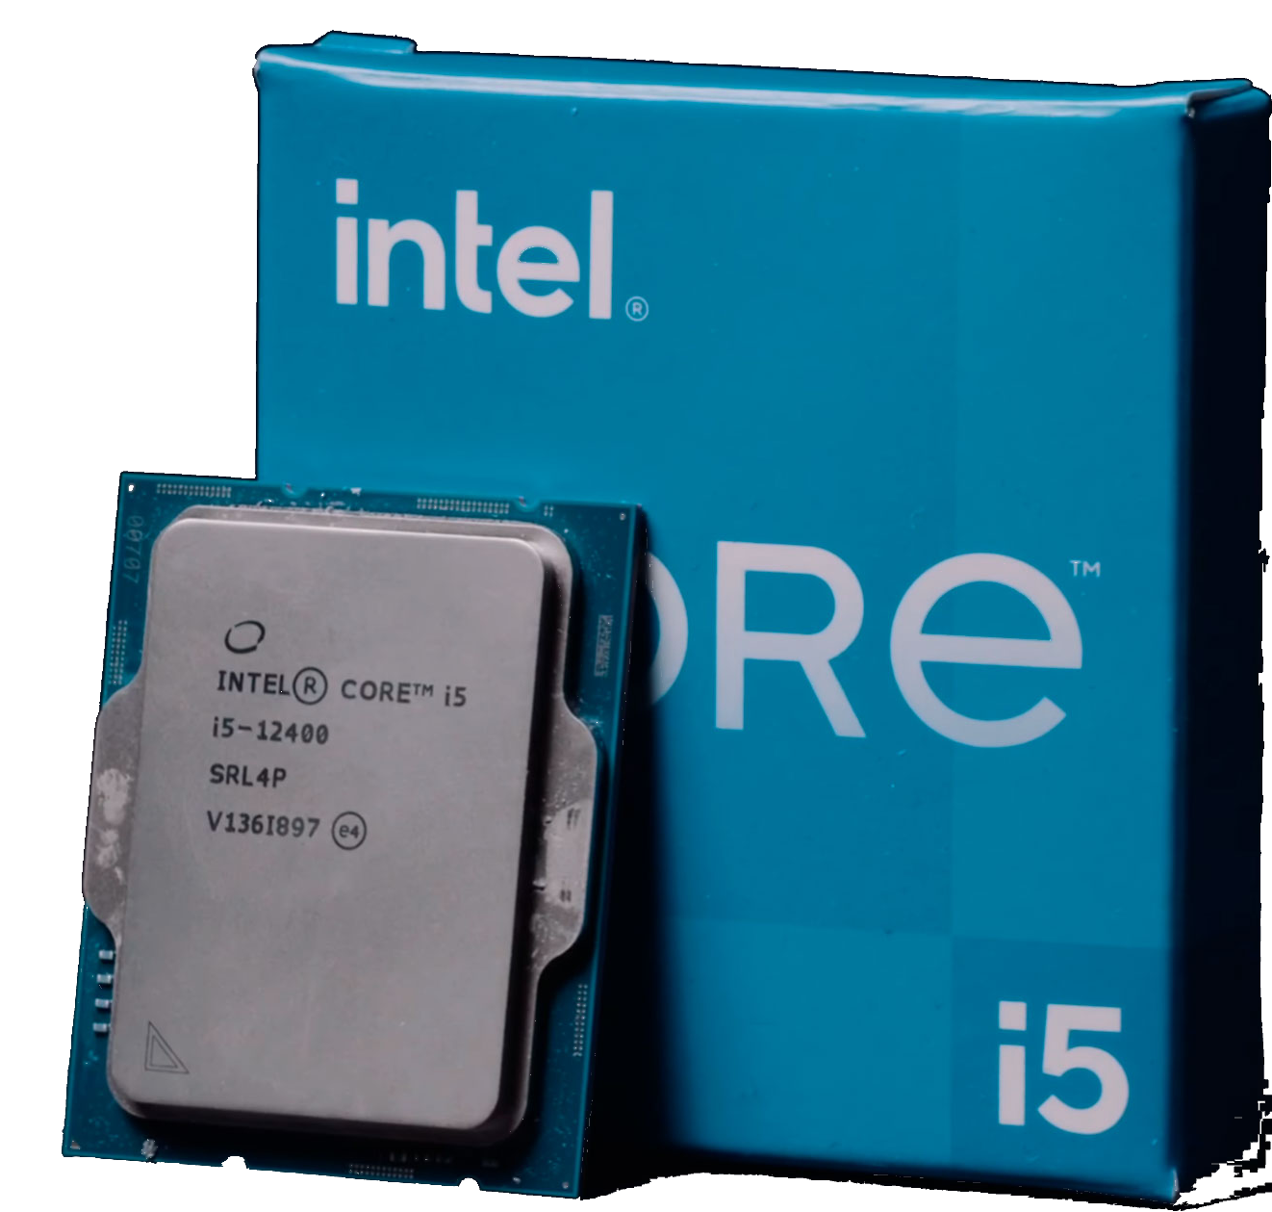
01
The CPU
Intel Core i5-12400
Best in its category (according to cpu.userbenchmark.com)
Supports DDR5
Only runs at 2.50 GHz
Retails for $149,99 (at MicroCenter)

Slide 4
TABLE OF CONTENTS
01
04
RAM
07
Storage
The CPU
02
The CPU Cooler
05
08
The GPU
The Case
03
The Motherboard
06
The Power Supply
09
Peripherals

Slide 5
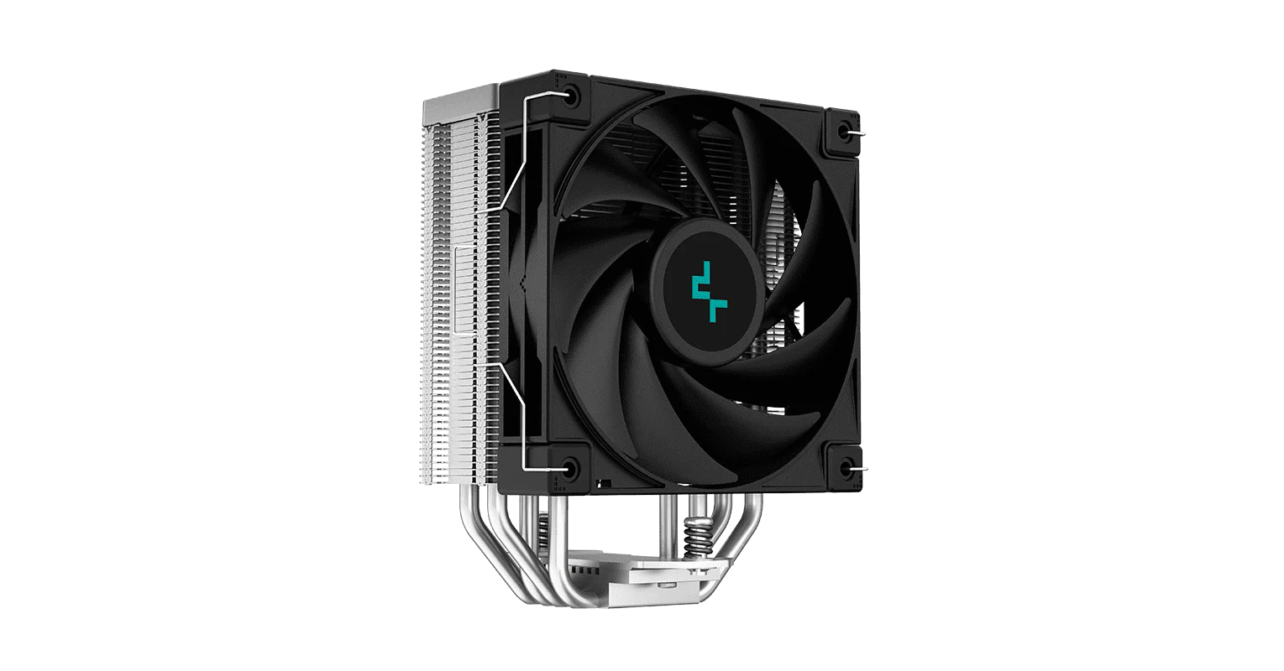
02
The CPU Cooler
DeepCool AK400
Quite good CPU cooler for its price
Gets the job done
Retails for $29,99 (at MicroCenter)

Slide 6
TABLE OF CONTENTS
01
04
RAM
07
Storage
The CPU
02
The CPU Cooler
05
08
The GPU
The Case
03
The Motherboard
06
The Power Supply
09
Peripherals

Slide 7
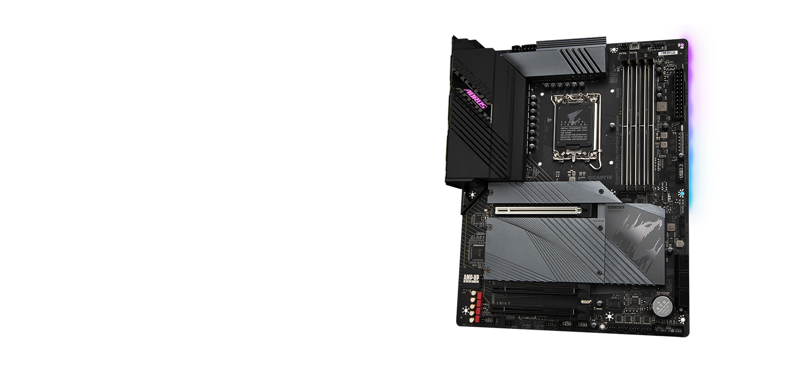
03
The Motherboard
Gigabyte Z690 Aorus Elite AX
LGA1700
Supports DDR5
Lots of ports
Integrated Wi-Fi adapter and sound card
Retails for $199,99 (at MicroCenter)

Slide 8
TABLE OF CONTENTS
01
04
RAM
07
Storage
The CPU
02
The CPU Cooler
05
08
The GPU
The Case
03
The Motherboard
06
The Power Supply
09
Peripherals

Slide 9
04
RAM
Crucial 16GB (2 x 8GB) DDR5 RAM
Really fast
Cheap for its category
Dual Channel
Retails for $49,99 (at MicroCenter)

Slide 10
TABLE OF CONTENTS
01
04
RAM
07
Storage
The CPU
02
The CPU Cooler
05
08
The GPU
The Case
03
The Motherboard
06
The Power Supply
09
Peripherals

Slide 11
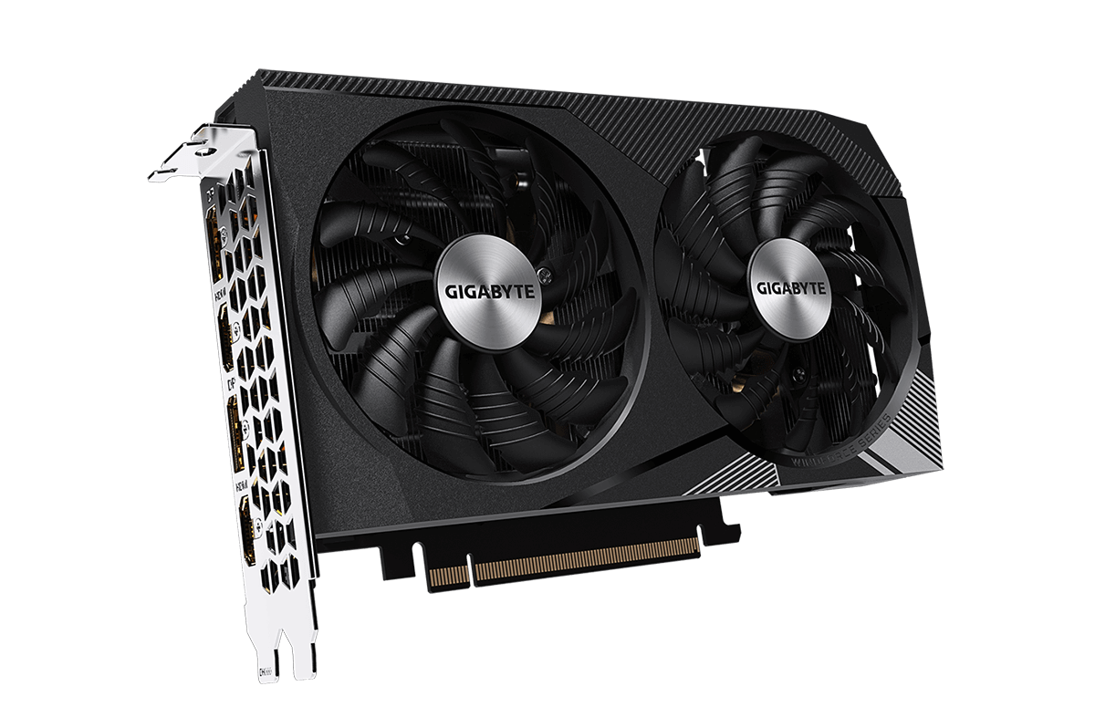
05
The GPU
Gigabyte – NVIDIA GeForce RTX 3060 OC 12GB GDDR6
2nd best in its price range (according to gpu.userbenchmark.com)
Hardware accelerated ray-tracing
Overclockable
Retails for $249,99 (at MicroCenter)

Slide 12
TABLE OF CONTENTS
01
04
RAM
07
Storage
The CPU
02
The CPU Cooler
05
08
The GPU
The Case
03
The Motherboard
06
The Power Supply
09
Peripherals

Slide 13
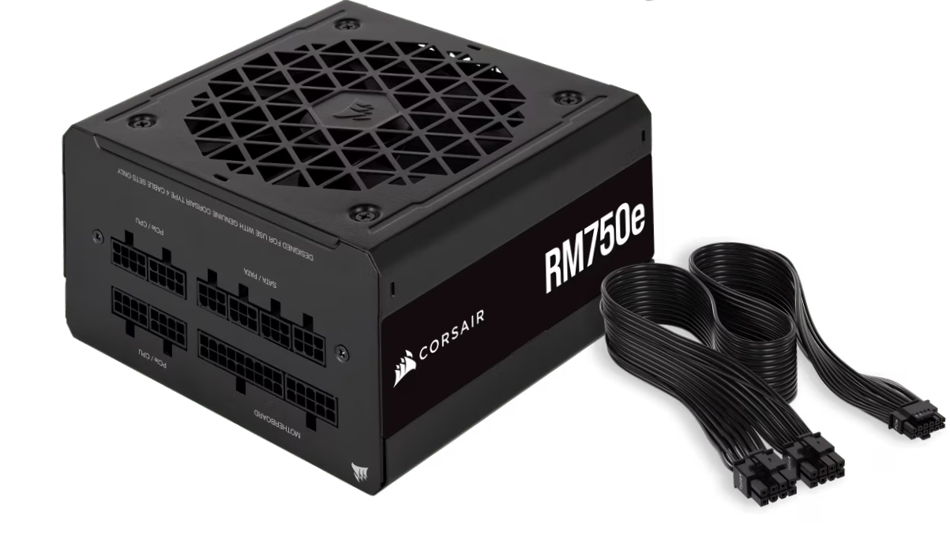
06
The Power Supply
Corsair RM750e
Gets the job done
750W
Room for PC upgrade
Retails for $99,99 (at MicroCenter)

Slide 14
TABLE OF CONTENTS
01
04
RAM
07
Storage
The CPU
02
The CPU Cooler
05
08
The GPU
The Case
03
The Motherboard
06
The Power Supply
09
Peripherals

Slide 15
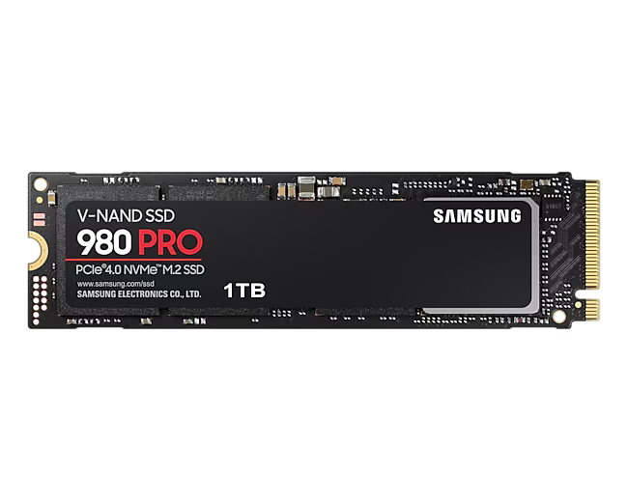
07
Storage
Samsung 980 Pro M.2 NVMe 1TB SSD
Fast, because PCIe 4.0
1TB is enough space for most people
Retails for $69,99 (at MicroCenter)

Slide 16
TABLE OF CONTENTS
01
04
RAM
07
Storage
The CPU
02
The CPU Cooler
05
08
The GPU
The Case
03
The Motherboard
06
The Power Supply
09
Peripherals

Slide 17
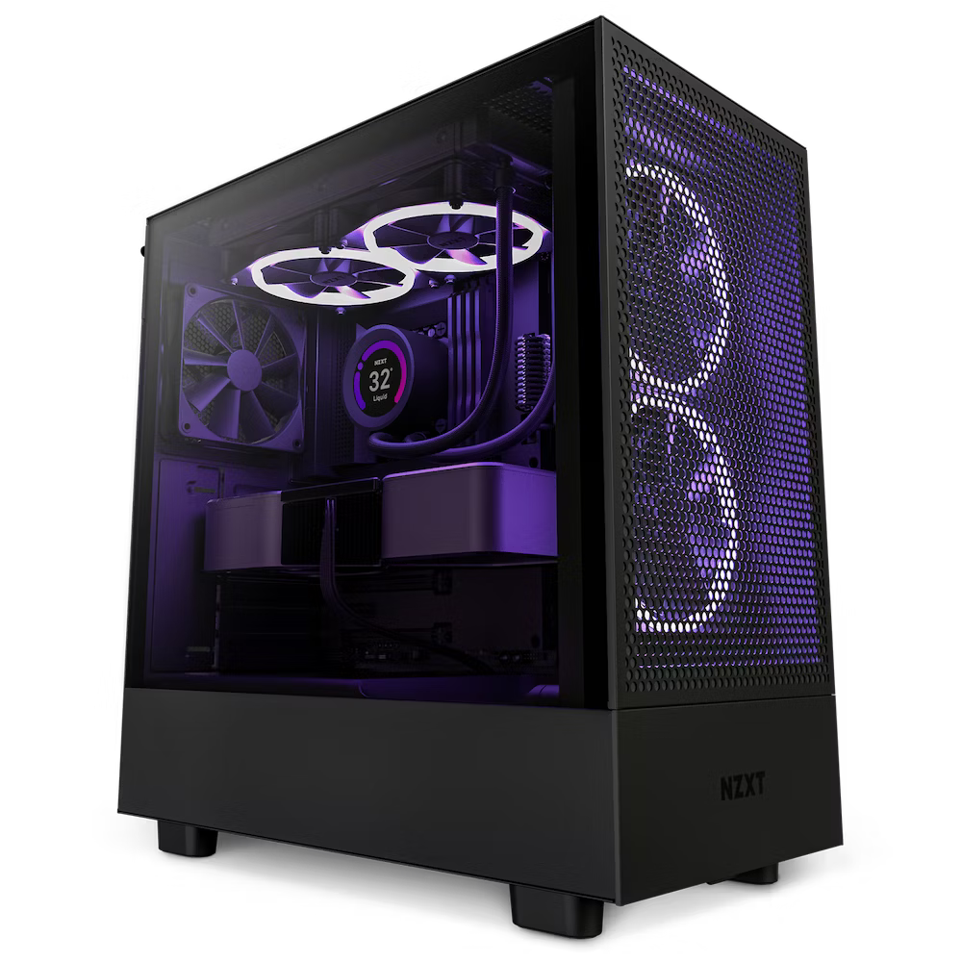
08
The Case
NZXT H5 Flow
ATX form factor
Lots of fans
Great quality for its price
Retails for $94,99 (at MicroCenter)

Slide 18
TOTAL OF THE PC
$944,92

Slide 19
TABLE OF CONTENTS
01
04
RAM
07
Storage
The CPU
02
The CPU Cooler
05
08
The GPU
The Case
03
The Motherboard
06
The Power Supply
09
Peripherals

Slide 20
09
PERIPHERALS

Slide 21
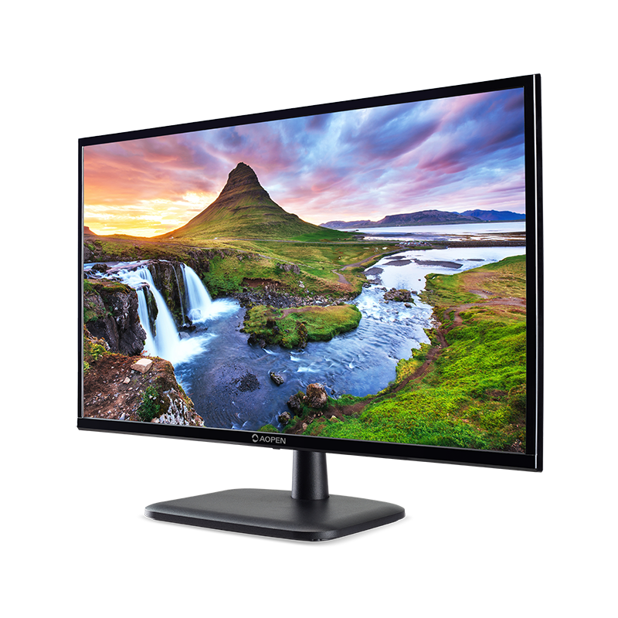
09
A Monitor
Acer 22CV1Q Full HD 21.5” LED Monitor
Great price
Full HD Monitor
Retails for $64,99 (at MicroCenter)

Slide 22
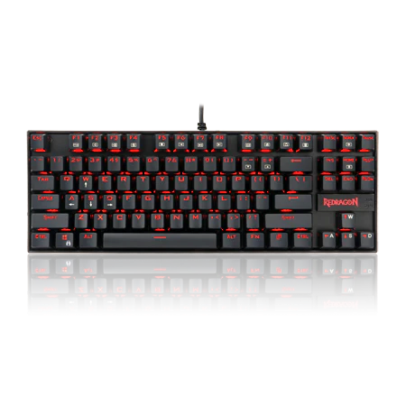
09
Keyboard
Redragon K552 75% Mechanical Keyboard
Blue Switch Mechanical Keyboard
Cheap
Retails for $34,99 (at MicroCenter)

Slide 23
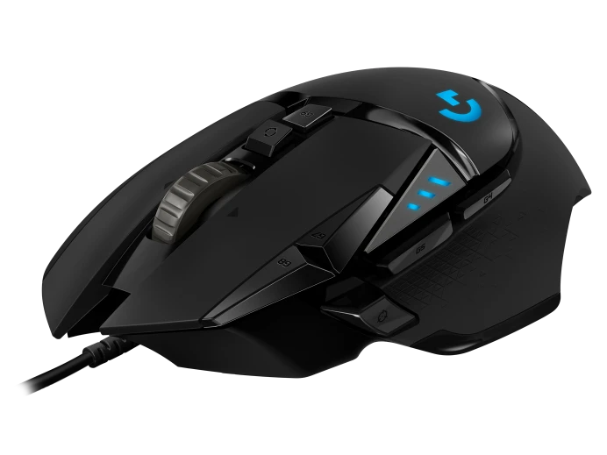
09
Mouse
Logitech G502 HERO Mouse
One of the best and most widely used gaming mouse
Customizable weight
Retails for $49,99 (at MicroCenter)

Slide 24
TOTAL OF THE PERIPHERALS
$149,97

Slide 25
IN TOTAL
$1094,89

Slide 26
THANK YOU FOR YOUR ATTENTION
And good luck with the cable management

